Slide 1
HPN Wind Rose Analysis
10 February 2020 - NT Hartman (Preliminary)

Slide 2
Executive Summary
Raw ASOS wind data was analyzed for HPN from 2006-2019. Wind direction is the primary factor in determining runway use. Analysis in this pack looks at 464,689 wind recordings across a 14 year period.
Data shows a clear increase of 16-favoring winds during the last several years relative to earlier periods. Every year from 2011 onwards saw more 16-favoring winds than 2006-10. 2013-18 saw a further uptick in 16-favoring winds (the period of the recent HMMH study)
Wind data also shows clear seasonality both during time of day and month of year. Observed seasonality impacts generally drive more traffic to use runway 16 during periods when sensitivity to aircraft noise is at its highest (afternoon daylight hours during the warmer months of the year when people are spending time outdoors).
The observed increases in 16-favoring winds are in line with the overall increase in traffic on the 16 approach reported by the HMMH study:
ASOS data from 2013 - 2018 shows a 21% increase in 16-favoring winds
HMMH study reported a 24% increase in ‘day’ 16 traffic and a 18% increase in ‘night’ traffic for 16 over the same period
Localized cyclic weather patterns can cause dramatic shifts in winds that in turn would likely result in dramatic shifts in runway use. For example, the transition from winter to summer in 2016 saw a 174% increase in 16-favoring winds over just a few months.
Significant empirical evidence would support the following logical conclusions from the 14 years worth of detailed wind data:
Atmospheric patterns have shifted over recent years to cause a consistent increase in the occurrence of 16-favoring winds. It is unclear if this pattern is part of a broader cycle or represents a more permanent shift.
This clear and sustained shift in wind is likely the primary cause for the observed proportional increases in arriving air traffic using runway 16 over the last several years

Slide 3
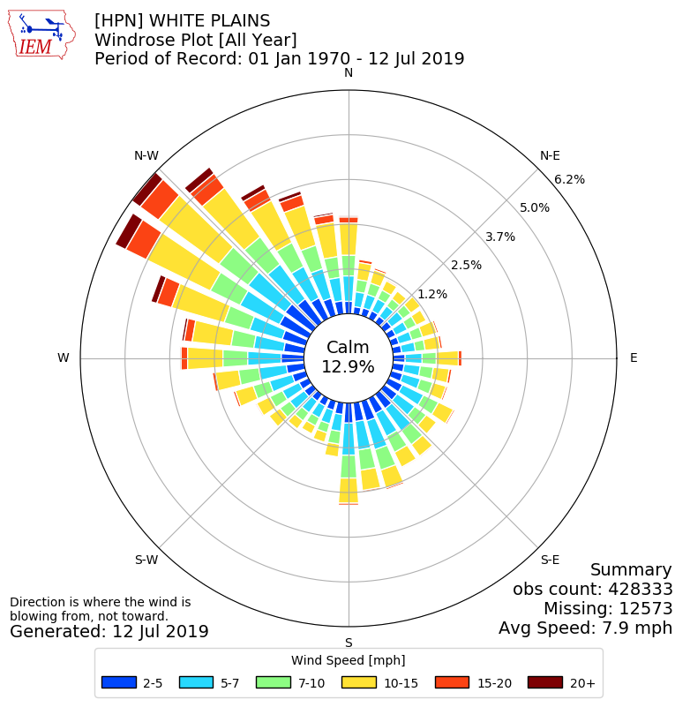
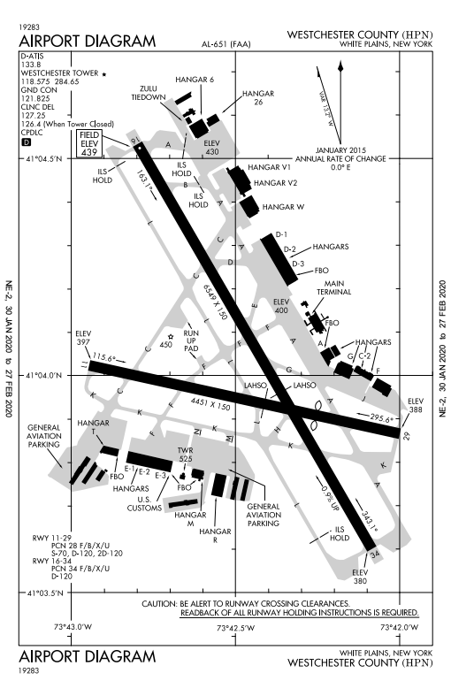
Raw Wind Rose View (1970-2019) Relative to HPN Runway Design
Key Observations:
Absent other limitations (terrain, property shape, etc.) airports generally build runways to align with prevailing wind patterns to limit cross-wind components
Prevailing winds at HPN generally come from either the Northwest or Southeast
As expected, HPN’s main runway (16-34) is oriented broadly along this axis
Runway 11-29 is available for smaller aircraft and is often used at the same time as 16-34 (29 with 34 and 11 with 16); however, this runway is too short for use by all but the smallest jets
16-34 also directly parallels the NY-CT state border which may have also been a limiting factor when originally designing the runway orientation
At HPN for all periods (year round including overnight periods) winds from the northwest (favoring 34) are more common than winds favoring runway 16. However, as subsequent pages will show there are some periods (e.g., summers in the afternoons) when winds consistently favor runway 16
Note that the chart at left was generated by an aggregation service that incorporates data from 1970-2019. All other analysis in this pack uses detailed individual recordings from 2006-2019 recorded every 5-60 minutes.
Wind rose from: https://mesonet.agron.iastate.edu/sites/windrose.phtml?station=HPN&network=NY_ASOS

Slide 4
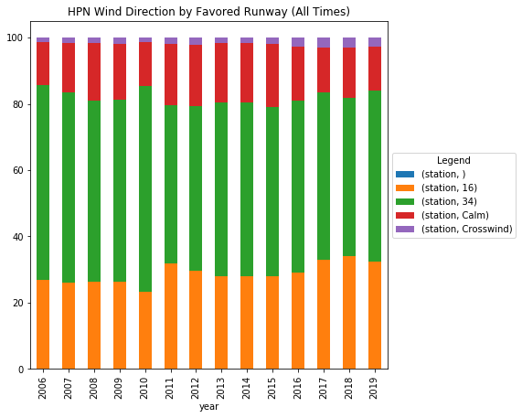
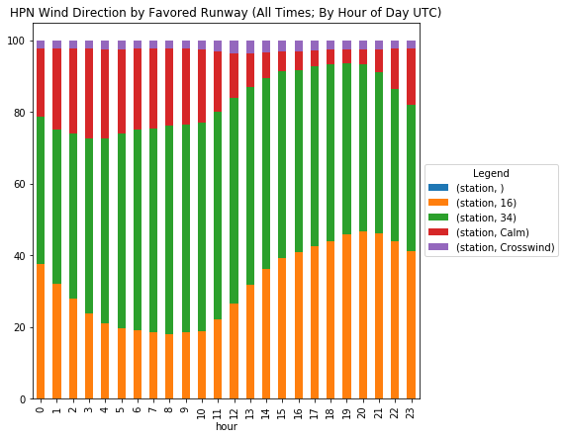
Raw Wind Data by Year and Time of Day (All Times)
+ 21%
Key Observations:
Recent years have seen an increase in winds that favor runway 16
It is significant that the 5 years with the smallest proportion of winds favoring 16 all occurred during the first 5 years of the dataset
Between 2013 and 2018 (period of HMMH study) winds favoring 16 went from 28% to 34% (a 21% increase)
Winds show clear cyclic hourly patterns with 16 winds increasing dramatically in the early afternoon hours (likely in part due to sea breeze)
Calm winds are somewhat common overnight, but rare during afternoons providing much less discretion over runway use; Direct crosswinds are also rare

Slide 5
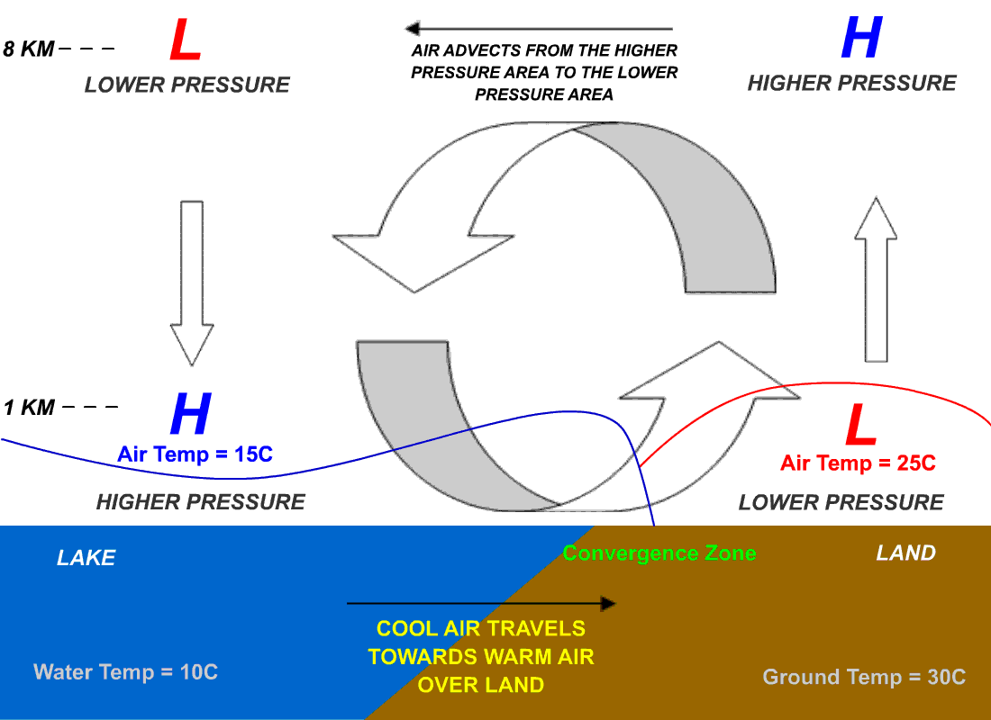
Sea breeze can contribute to southerly winds as landmass warms throughout the day
Key Observations:
There is a clear increase in 16-favoring winds as a day progresses
There are likely many factors at play, but one could be the ‘sea breeze’ effect, which creates localized low pressure over land masses adjacent to water
Sea breeze figure: https://en.wikipedia.org/wiki/Sea_breeze#/media/File:LAKE_BREEZE.gif CC BY-SA 3.0

Slide 6
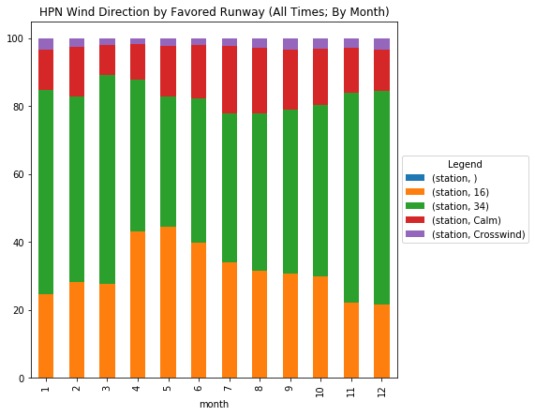
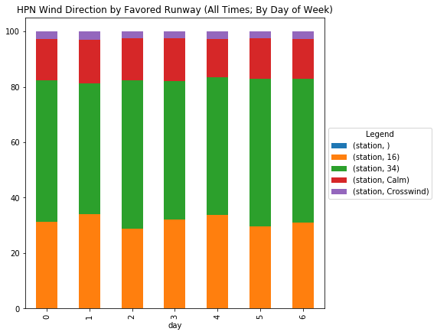
Raw Wind Data by Month and Day of Week (All Times, 2006-2019)
+ 106%
Key Observations:
Seasonality also follows an a annual pattern, with 16-favoring winds much more common during warmer months of the year
Across 2006-19 seasonal variance between December (21.6% 16) and May (44.4% 16) sees a 106% increase in 16-favoring winds during warmer months
Put another way, season wind direction changes alone could frequently account for a more than doubling of traffic using 16 during warmer months of the year relative to other times of year. Peak 16 wind-driven usage would occur around noise-sensitive outdoor holidays like Memorial Day.
Across 2006-18 there is no clear pattern by day of week (0 = Mon, 6 = Sun). This is as expected across the 14 year period, although as seen later localized annual patterns favoring certain days of the week can develop.

Slide 7
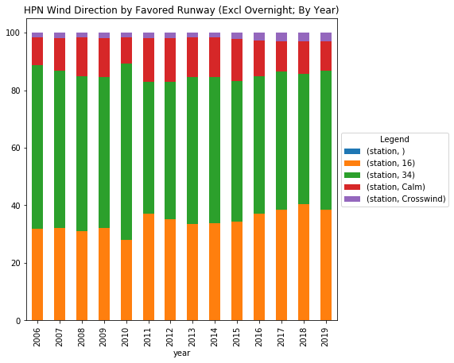
Raw Wind Data by Year (Excluding Overnight Periods of 5Z - 12Z)
+ 21%
Key Observations:
HPN sees relativity little traffic during the overnight period and thus the results were re-run looking only at times when the airport has steady traffic (excluding 5Z - 12Z)
The overall pattern remains broadly the same with recent years seeing an increase in 16-favoring winds
Between 2013-18 (period of the HMMH study) 16-favoring winds excluding overnight periods increased by 21%, which is also broadly in line with reported traffic increases

Slide 8
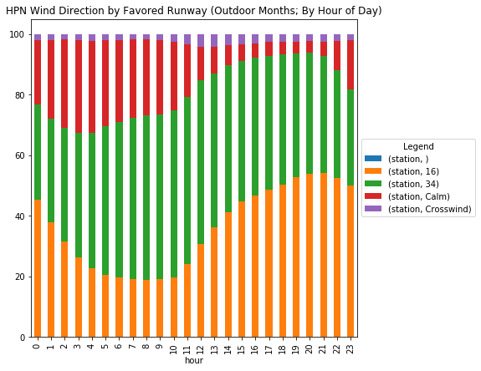
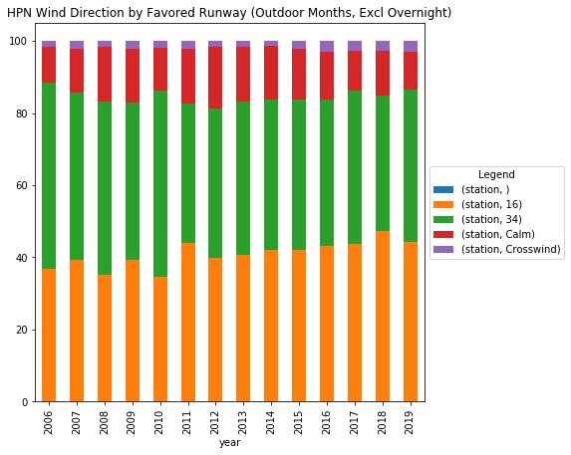
Wind Data for ‘Outdoor Months’ (Apr through Oct)
Overnight
Key Observations:
Sensitivity to noise is often higher during warmer months of the year when more people are outside
Data shows a clear trend of increased 16-favoring winds during the Apr-Oct period each year
The mid 2000s (2006-08) saw average 16-favoring winds 37% of the time, but in the last 3 years (2017-2019) this proportion has increased to 45% or an increase of 22% with a steady increase over the last ~8 years
This critical time for noise sensitivity (outdoor months during afternoon hours) is the most likely time to have 16-favoring winds
This critical period (afternoons) also has very limited periods where runway choice exists due to the limited amount of calm wind periods

Slide 9
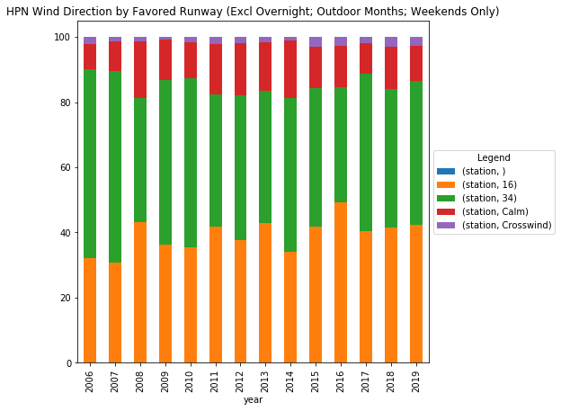
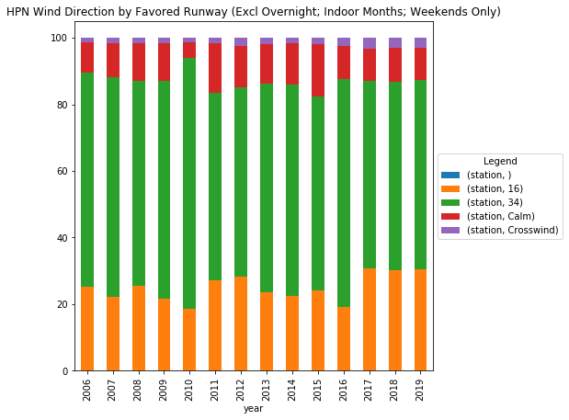
Localized seasonal patterns can cause dramatic shifts in perceived winds over short periods of time Outdoor months = April through Oct; Indoor months = November through March
+ 174%
Key Observations:
Across many years, day of week does not reveal a significant wind distribution pattern
However, across any given year it is possible that cyclic weather patterns can develop such that certain days of the week see consistent patterns
Such localized patterns can result in dramatic shifts in wind (and thus traffic) over short periods of time
For example when looking at weekend days 2016 saw the most 16-favoring winds over a 14 year period during ‘outdoor’ months but saw the least 16-favoring winds during ‘indoor’ months in the same year
In that year ‘summer’ would have seen a 174% increase in 16-favoring winds over just a short period of time (with traffic numbers likely in line with that wind shift). In general, key outdoor holidays (e.g., Memorial Day) are right after the peak point when 16-favoring winds would have dramatically increased from the winter periods when winds favor 34

Slide 10
Additional notes:
Wind data is recorded on regular intervals (every hour for 2006-2015 and every 5 minutes for 2016-present)
Wind direction is the primary factor in determining which runway is used for arrivals/departures. To maximize performance and safety, aircraft take-off and land into the wind.
Analysis presented here considered only the wind direction (or lack of wind for calm periods). Other factors such as vertical and horizontal visibility may also impact runway choice, particularly when winds are calm. For example, Runway 16 is the ‘bad weather’ runway for HPN with an approach lighting system, CAT-I SA and CAT-II instrument landing system. Runway 16 offers significantly lower landing weather minimums than runway 34 (down to 113 ft radar altitude and 1200 ft forward runway visual range visibility). Thus some of the periods labeled herein as ‘calm’ may have other factors that could make 16 a more attractive runway than 34. Such low-visibility scenarios are generally an edge case in any given month, but factors generally favor runway 16 over 34.
Wind analysis is showing the proportion of time that various runway-favoring winds exist. Actual traffic arriving/departing from HPN is not evenly distributed every hour. Thus the actual impact of wind pattern changes on traffic may be more or less than the proportional change in wind directions. However, over broad periods of time the two changes should be broadly similar as was observed with the HMMH traffic analysis.
All times for ASOS data are recorded in Zulu time (UTC) and all analysis presented uses UTC. HPN is located at either -5 or -6 hours from Zulu time depending on the season (EDT vs EST).
It is unclear if the observed shifts in wind patterns are part of a multi-year cycle or something more permanent.

Slide 11
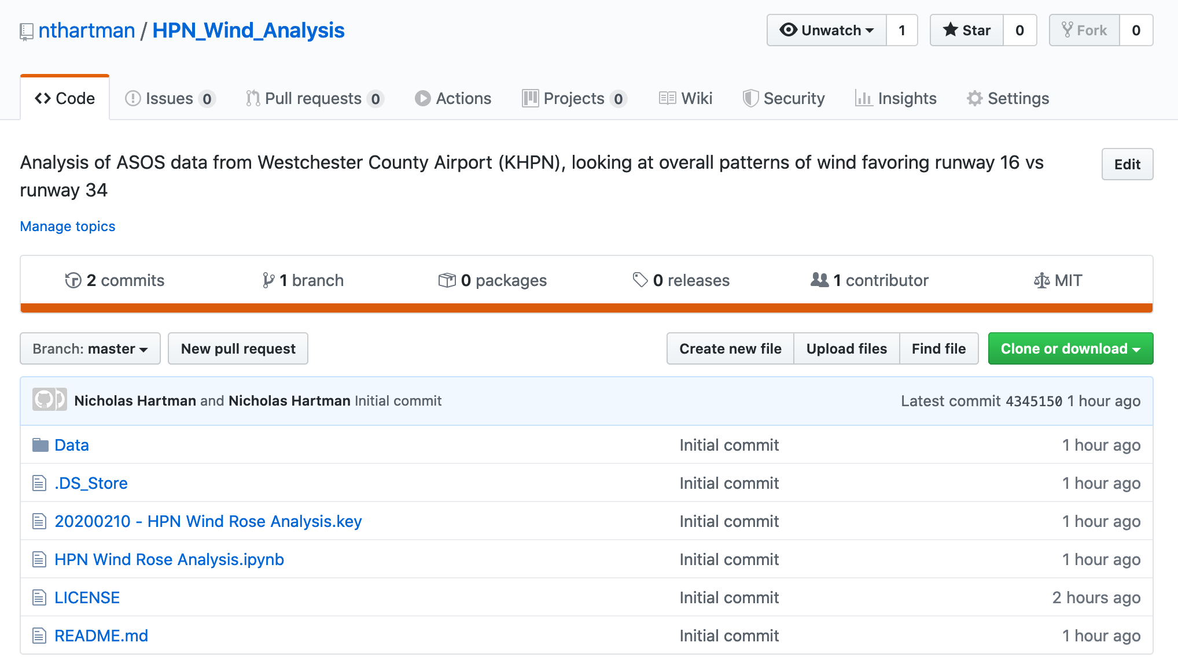
Supporting materials:
Copies of the raw data along with all code used for collecting and analyzing ASOS data is available at: https://github.com/nthartman/HPN_Wind_Analysis

